Slide 1
HUMAN GROWTH AND DEVELOPMENT
School Health Rotation
صحة المدارس (School Health Rotation)
Human Growth and Development · Practical Lectures
Source document: Chapter 7 — School Health Rotation.pdf
5 pages · Nursing Lectures · Level 26–27
Notes:
Title slide generated from Chapter 7 — School Health Rotation.pdf (5 pages). Source text is reproduced verbatim in the notes of every content slide.

Slide 2
HUMAN GROWTH AND DEVELOPMENT
Chapter Overview & Objectives
Scope of this chapter
Health services for the school-age child (6-12 years): the school nurse's roles, school entry appraisal, screening programs (vision, hearing, scoliosis, dental, weight status), immunization compliance, emergency care and first aid, in-school medication, and communicable-disease control.
Learning outcomes — the document's own sections
• 7.1 Site Profile — The School Health Program (p. 1)
• 7.2 School Entry Health Screening (p. 2)
• 7.3 Screening Programs (p. 3)
• 7.4 Immunization Compliance & Records (p. 3)
• 7.5 Emergency Care & First Aid (p. 4)
• 7.6 Medication Administration at School (p. 4)
• 7.7 Health Education & Communicable Disease Control (p. 4)
School Health Rotation
1
Notes:
Overview assembled verbatim from page 1 and the numbered headings of Chapter 7 — School Health Rotation.pdf.

Slide 3
HUMAN GROWTH AND DEVELOPMENT
Contents
7.1 7.1 Site Profile — The School Health Program — p. 1
7.2 7.2 School Entry Health Screening — p. 2
7.3 7.3 Screening Programs — p. 3
7.4 7.4 Immunization Compliance & Records — p. 3
7.5 7.5 Emergency Care & First Aid — p. 4
7.6 7.6 Medication Administration at School — p. 4
7.7 7.7 Health Education & Communicable Disease Control — p. 4
School Health Rotation
2
Notes:
Section headings exactly as numbered in the source document.

Slide 4
HUMAN GROWTH AND DEVELOPMENT
7.1 Site Profile — The School Health Program
Source page 1 of 5
ROTATION: SCHOOL HEALTH
Chapter 7 — School Health Rotation
Health services for the school-age child (6-12 years): the school nurse's roles, school entry
appraisal, screening programs (vision, hearing, scoliosis, dental, weight status), immunization
compliance, emergency care and first aid, in-school medication, and communicable-disease
control.
Age range: 6 – 12 years
School nurses assume a major role in the school health program and can significantly affect the
lives of school-age children. Working collaboratively with the school and community, they
provide health supervision, health counseling, and health education.
RESPONSIBILITIES OF THE SCHOOL NURSE
School Health Rotation
3
Notes:
ROTATION: SCHOOL HEALTH
Chapter 7 — School Health Rotation
Health services for the school-age child (6-12 years): the school nurse's roles, school entry
appraisal, screening programs (vision, hearing, scoliosis, dental, weight status), immunization
compliance, emergency care and first aid, in-school medication, and communicable-disease
control.
Age range: 6 – 12 years
7.1 Site Profile — The School Health Program
School nurses assume a major role in the school health program and can significantly affect the
lives of school-age children. Working collaboratively with the school and community, they
provide health supervision, health counseling, and health education.
RESPONSIBILITIES OF THE SCHOOL NURSE
Education and interventions for acute and chronic illness, safety, health promotion, nutrition,
mental health, dental disease, and sexually transmitted infections.
For some children, especially those in poverty, the school nurse may be the only contact with illness
prevention and health promotion.
For children with chronic conditions: leadership within the school health team, assessing health
status, identifying barriers to learning, and developing an individualized health care plan.
In school-based health centers, nurse practitioners provide primary care — treatment of acute
illness, vision/hearing screening, sports participation examinations, nutrition counseling, and
anticipatory guidance.
Unlicensed assistive personnel (UAP) may be part of the team — state-certified paraprofessionals
who assist a professional under supervision.
Figure 7.1 shows the coordinated school health program and the core services that sit inside its
health-services component — appraisal, emergency care, immunization compliance,
communicable-disease control, and referral.

Slide 5
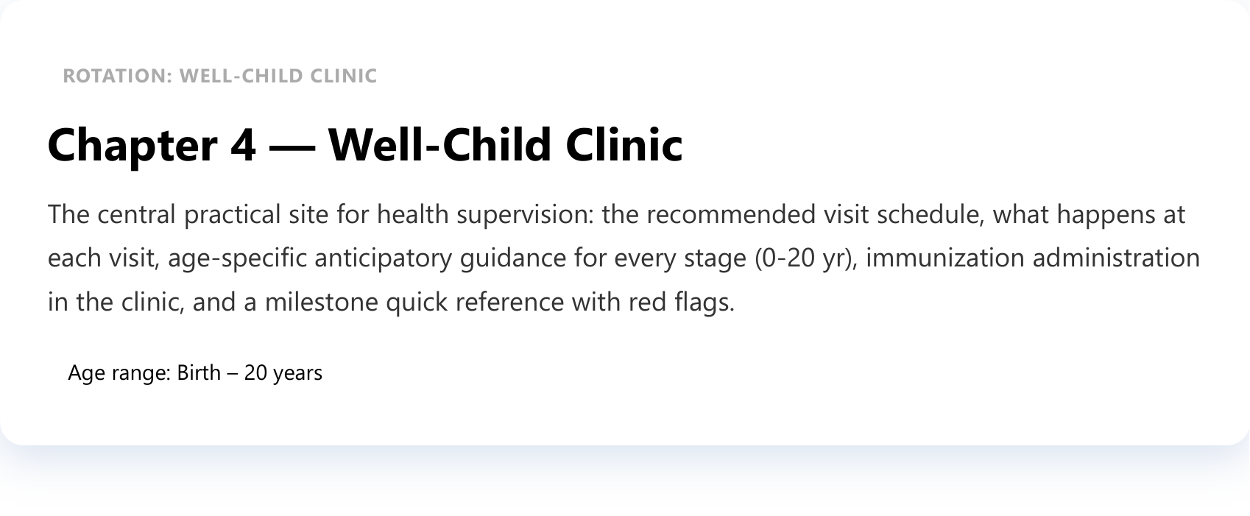
HUMAN GROWTH AND DEVELOPMENT
7.1 Site Profile — The School Health Program
Source page 1 of 5 (continued)
Education and interventions for acute and chronic illness, safety, health promotion, nutrition,
mental health, dental disease, and sexually transmitted infections.
For some children, especially those in poverty, the school nurse may be the only contact with illness
prevention and health promotion.
For children with chronic conditions: leadership within the school health team, assessing health
status, identifying barriers to learning, and developing an individualized health care plan.
In school-based health centers, nurse practitioners provide primary care — treatment of acute
illness, vision/hearing screening, sports participation examinations, nutrition counseling, and
anticipatory guidance.
Unlicensed assistive personnel (UAP) may be part of the team — state-certified paraprofessionals
who assist a professional under supervision.
Figure 7.1 shows the coordinated school health program and the core services that sit inside its
health-services component — appraisal, emergency care, immunization compliance,
communicable-disease control, and referral.
School Health Rotation
4
Notes:
ROTATION: SCHOOL HEALTH
Chapter 7 — School Health Rotation
Health services for the school-age child (6-12 years): the school nurse's roles, school entry
appraisal, screening programs (vision, hearing, scoliosis, dental, weight status), immunization
compliance, emergency care and first aid, in-school medication, and communicable-disease
control.
Age range: 6 – 12 years
7.1 Site Profile — The School Health Program
School nurses assume a major role in the school health program and can significantly affect the
lives of school-age children. Working collaboratively with the school and community, they
provide health supervision, health counseling, and health education.
RESPONSIBILITIES OF THE SCHOOL NURSE
Education and interventions for acute and chronic illness, safety, health promotion, nutrition,
mental health, dental disease, and sexually transmitted infections.
For some children, especially those in poverty, the school nurse may be the only contact with illness
prevention and health promotion.
For children with chronic conditions: leadership within the school health team, assessing health
status, identifying barriers to learning, and developing an individualized health care plan.
In school-based health centers, nurse practitioners provide primary care — treatment of acute
illness, vision/hearing screening, sports participation examinations, nutrition counseling, and
anticipatory guidance.
Unlicensed assistive personnel (UAP) may be part of the team — state-certified paraprofessionals
who assist a professional under supervision.
Figure 7.1 shows the coordinated school health program and the core services that sit inside its
health-services component — appraisal, emergency care, immunization compliance,
communicable-disease control, and referral.

Slide 6
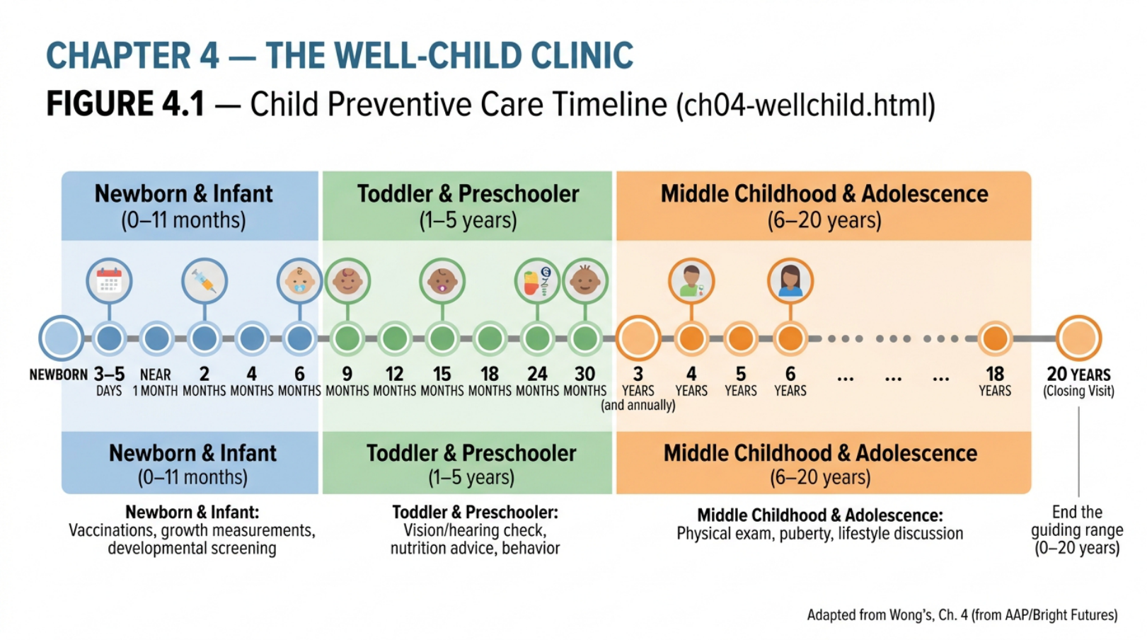
HUMAN GROWTH AND DEVELOPMENT
7.2 School Entry Health Screening
Source page 2 of 5
Figure 7.1 The coordinated school health program and the core services of its health-services
component.
Health appraisal at school entry covers screening tests (vision, hearing), measurements (height,
weight), and medical, dental, and psychologic examinations.
School Health Rotation
5
Notes:
Figure 7.1 The coordinated school health program and the core services of its health-services
component.
7.2 School Entry Health Screening
Health appraisal at school entry covers screening tests (vision, hearing), measurements (height,
weight), and medical, dental, and psychologic examinations.
Appraisal item
Content
History
Interval history (feeding, elimination, sleep, behavior, past illness, allergies,
medications), immunization record; family health and psychosocial history
Measurements
Height and weight on CDC charts (2-20 yr); BMI for weight status — school-age
obesity prevalence ~17%; blood pressure annually
Physical exam
Head-to-toe (eye acuity — Snellen letters for school-age; ear/hearing — pure-tone
audiometry; spine — scoliosis screening §7.3; skin; teeth; abdomen; extremities)
Immunization
review
Check the record against the printed schedule (see Ch. 4 §4.5); vaccines are required
in most states before school entry

Slide 7
HUMAN GROWTH AND DEVELOPMENT
7.2 School Entry Health Screening
Source page 2 of 5 (continued)
Appraisal item | Content
History | Interval history (feeding, elimination, sleep, behavior, past illness, allergies, medications), immunization record; family health and psychosocial history
Measurements Height and weight on CDC charts (2-20 yr); BMI for weight status — school-age obesity prevalence ~17%; blood pressure annually
Physical exam | Head-to-toe (eye acuity — Snellen letters for school-age; ear/hearing — pure-tone audiometry; spine — scoliosis screening §7.3; skin; teeth; abdomen; extremities)
Immunization Check the record against the printed schedule (see Ch. 4 §4.5); vaccines are required review in most states before school entry
School Health Rotation
6
Notes:
Figure 7.1 The coordinated school health program and the core services of its health-services
component.
7.2 School Entry Health Screening
Health appraisal at school entry covers screening tests (vision, hearing), measurements (height,
weight), and medical, dental, and psychologic examinations.
Appraisal item
Content
History
Interval history (feeding, elimination, sleep, behavior, past illness, allergies,
medications), immunization record; family health and psychosocial history
Measurements
Height and weight on CDC charts (2-20 yr); BMI for weight status — school-age
obesity prevalence ~17%; blood pressure annually
Physical exam
Head-to-toe (eye acuity — Snellen letters for school-age; ear/hearing — pure-tone
audiometry; spine — scoliosis screening §7.3; skin; teeth; abdomen; extremities)
Immunization
review
Check the record against the printed schedule (see Ch. 4 §4.5); vaccines are required
in most states before school entry

Slide 8
HUMAN GROWTH AND DEVELOPMENT
7.3 Screening Programs
Source page 3 of 5
Tuberculosis / special screens | Follow the ministry/school regulatory screening requirements
Psychologic / social Stress signals to explore: stomach pains/headache, sleep problems, bed-wetting, eating-habit changes, aggressive/stubborn behavior, reluctance to participate, regression; domestic-violence exposure risk awareness
Screen | Method and referral
Vision | Distance acuity with Snellen letters (or numbers, tumbling E, HOTV) — referral: fewer than 4 of 6 correct on the 20-foot (6-m) line; alignment: corneal light reflex + cover test at near (33 cm) and far (6 m)
Hearing Pure-tone audiometry at 0.5, 1, 2, and 4 kHz; fails if tones cannot be heard at 20 dB HL; tympanometry for middle-ear function
Scoliosis | With the child standing in underpants (bra for older girls) observe from behind — asymmetry of shoulders and hips; with forward bend (back parallel to the floor) observe from the side for rib-cage asymmetry/prominence; investigate a slight limp, crooked hemline, or sore back; inspect the spine for tufts of hair, dimples, or discoloration. Scoliosis is especially important in girls
Weight Plot height and weight on CDC charts; BMI for age; school-age obesity prevalence ~17%, status / higher in rural/socioeconomically distressed families; the school nurse takes an active role in BMI nutrition
Dental | Brush 2-3×/day for 2-3 minutes with fluoridated toothpaste; floss at least once daily; soft toothbrush changed every 3-4 months; dental examinations every 6 months; dental sealants recommended for all school-age children
7.4 Immunization Compliance & Records
Before school entry: immunizations are required in most states before entry, part of communicable-
disease-control attendance policy.
At every contact: verify the record, check live-vaccine timing, and arrange catch-up (Ch. 4 §4.5).
School Health Rotation
7
Notes:
Tuberculosis /
special screens
Follow the ministry/school regulatory screening requirements
Psychologic / social
Stress signals to explore: stomach pains/headache, sleep problems, bed-wetting,
eating-habit changes, aggressive/stubborn behavior, reluctance to participate,
regression; domestic-violence exposure risk awareness
7.3 Screening Programs
Screen
Method and referral
Vision
Distance acuity with Snellen letters (or numbers, tumbling E, HOTV) — referral: fewer than 4 of
6 correct on the 20-foot (6-m) line; alignment: corneal light reflex + cover test at near (33 cm)
and far (6 m)
Hearing
Pure-tone audiometry at 0.5, 1, 2, and 4 kHz; fails if tones cannot be heard at 20 dB HL;
tympanometry for middle-ear function
Scoliosis
With the child standing in underpants (bra for older girls) observe from behind — asymmetry
of shoulders and hips; with forward bend (back parallel to the floor) observe from the side for
rib-cage asymmetry/prominence; investigate a slight limp, crooked hemline, or sore back;
inspect the spine for tufts of hair, dimples, or discoloration. Scoliosis is especially important in
girls
Weight
status /
BMI
Plot height and weight on CDC charts; BMI for age; school-age obesity prevalence ~17%,
higher in rural/socioeconomically distressed families; the school nurse takes an active role in
nutrition
Dental
Brush 2-3×/day for 2-3 minutes with fluoridated toothpaste; floss at least once daily; soft
toothbrush changed every 3-4 months; dental examinations every 6 months; dental sealants
recommended for all school-age children
7.4 Immunization Compliance & Records
Before school entry: immunizations are required in most states before entry, part of communicable-
disease-control attendance policy.
At every contact: verify the record, check live-vaccine timing, and arrange catch-up (Ch. 4 §4.5).

Slide 9
HUMAN GROWTH AND DEVELOPMENT
7.5 Emergency Care & First Aid
Source page 4 of 5
Routine boosters: the booster ages for this age band follow the official printed schedule; the
adolescent items (MenACWY, Tdap, HPV, annual influenza, HepB/HepA, varicella) are covered in
Chapter 8.
Emergency care & safety: emergency treatment (first aid), notification of parents, and transportation
of the ill or injured child to home or hospital.
Chronic conditions: develop an individualized health care plan (IHP) — the nurse assesses health
status and identifies barriers to education; known allergy/asthma/seizure students follow their IHP
and facility protocol.
Sports: participation physical examinations at least every 2 years; the school nurse practitioner
performs them in school-based centers.
First-aid training: first-aid measures and child CPR are taught to parents; facility drills and kit
contents follow school/ministry policy.
Injury-prevention baseline: accidental injury remains the leading cause of death for children 1-14
years; motor-vehicle crashes are the most common cause of severe accidental injury/death for
school-age children.
7.6 Medication Administration at School
School Health Rotation
8
Notes:
Routine boosters: the booster ages for this age band follow the official printed schedule; the
adolescent items (MenACWY, Tdap, HPV, annual influenza, HepB/HepA, varicella) are covered in
Chapter 8.
7.5 Emergency Care & First Aid
Emergency care & safety: emergency treatment (first aid), notification of parents, and transportation
of the ill or injured child to home or hospital.
Chronic conditions: develop an individualized health care plan (IHP) — the nurse assesses health
status and identifies barriers to education; known allergy/asthma/seizure students follow their IHP
and facility protocol.
Sports: participation physical examinations at least every 2 years; the school nurse practitioner
performs them in school-based centers.
First-aid training: first-aid measures and child CPR are taught to parents; facility drills and kit
contents follow school/ministry policy.
Injury-prevention baseline: accidental injury remains the leading cause of death for children 1-14
years; motor-vehicle crashes are the most common cause of severe accidental injury/death for
school-age children.
7.6 Medication Administration at School
SAFETY ANCHORS AND POLICY LABELS
Medications must have child-safety caps; never leave any medication within a child's reach; "child-
resistant" is not "child-proof".
Children with chronic conditions receive care coordinated through the individualized health care
plan.
UAP assist a professional under supervision — who may administer, storage, dose verification,
parental permission, and documentation follow the school's written policy and local law.
7.7 Health Education & Communicable Disease Control
Health education: the school curriculum is a planned, sequential kindergarten-to-grade-12 program
addressing physical, mental, emotional, and social dimensions of health.

Slide 10
HUMAN GROWTH AND DEVELOPMENT
7.5 Emergency Care & First Aid
Source page 4 of 5 (continued)
SAFETY ANCHORS AND POLICY LABELS
Medications must have child-safety caps; never leave any medication within a child's reach; "child-
resistant" is not "child-proof".
Children with chronic conditions receive care coordinated through the individualized health care
plan.
UAP assist a professional under supervision — who may administer, storage, dose verification,
parental permission, and documentation follow the school's written policy and local law.
7.7 Health Education & Communicable Disease Control
Health education: the school curriculum is a planned, sequential kindergarten-to-grade-12 program
addressing physical, mental, emotional, and social dimensions of health.
School Health Rotation
9
Notes:
Routine boosters: the booster ages for this age band follow the official printed schedule; the
adolescent items (MenACWY, Tdap, HPV, annual influenza, HepB/HepA, varicella) are covered in
Chapter 8.
7.5 Emergency Care & First Aid
Emergency care & safety: emergency treatment (first aid), notification of parents, and transportation
of the ill or injured child to home or hospital.
Chronic conditions: develop an individualized health care plan (IHP) — the nurse assesses health
status and identifies barriers to education; known allergy/asthma/seizure students follow their IHP
and facility protocol.
Sports: participation physical examinations at least every 2 years; the school nurse practitioner
performs them in school-based centers.
First-aid training: first-aid measures and child CPR are taught to parents; facility drills and kit
contents follow school/ministry policy.
Injury-prevention baseline: accidental injury remains the leading cause of death for children 1-14
years; motor-vehicle crashes are the most common cause of severe accidental injury/death for
school-age children.
7.6 Medication Administration at School
SAFETY ANCHORS AND POLICY LABELS
Medications must have child-safety caps; never leave any medication within a child's reach; "child-
resistant" is not "child-proof".
Children with chronic conditions receive care coordinated through the individualized health care
plan.
UAP assist a professional under supervision — who may administer, storage, dose verification,
parental permission, and documentation follow the school's written policy and local law.
7.7 Health Education & Communicable Disease Control
Health education: the school curriculum is a planned, sequential kindergarten-to-grade-12 program
addressing physical, mental, emotional, and social dimensions of health.

Slide 11
HUMAN GROWTH AND DEVELOPMENT
School Health Rotation
Source page 5 of 5
Communicable-disease control: detection and exclusion of affected children, with policies for
readmission and attendance.
Nutrition services: school meal programs furnish one third of the daily recommended allowance; the
average school lunch may exceed guidelines for saturated and total fat — healthful choices (fruits,
vegetables, low-fat milk) are reinforced.
Hand hygiene: routine handwashing before and after every meal, toileting, and child contact.
Head lice, absentee surveillance, and reporting: school policies for detection,
exclusion/readmission, and disease reporting follow local regulations.
Chapter 7 Learning Check
Self-assessment questions (answer in your notebook, then open)
End of Chapter 7.
School Health Rotation
10
Notes:
Communicable-disease control: detection and exclusion of affected children, with policies for
readmission and attendance.
Nutrition services: school meal programs furnish one third of the daily recommended allowance; the
average school lunch may exceed guidelines for saturated and total fat — healthful choices (fruits,
vegetables, low-fat milk) are reinforced.
Hand hygiene: routine handwashing before and after every meal, toileting, and child contact.
Head lice, absentee surveillance, and reporting: school policies for detection,
exclusion/readmission, and disease reporting follow local regulations.
Chapter 7 Learning Check
Self-assessment questions (answer in your notebook, then open)
End of Chapter 7.

Slide 12
Document Information
School Health Rotation
صحة المدارس (School Health Rotation)
Source file: Chapter 7 — School Health Rotation.pdf
Pages in source: 5
Slides in this deck: 12
Course: Human Growth and Development — Practical Lectures
Full readable text and the original file are available on the lecture platform:
https://moustafaali-prog.github.io/growth-development-lectures/lectures/practical/Chapter 7 — School Health Rotation.html
Notes:
Closing slide. Content reproduced verbatim from Chapter 7 — School Health Rotation.pdf.

